Slide 1
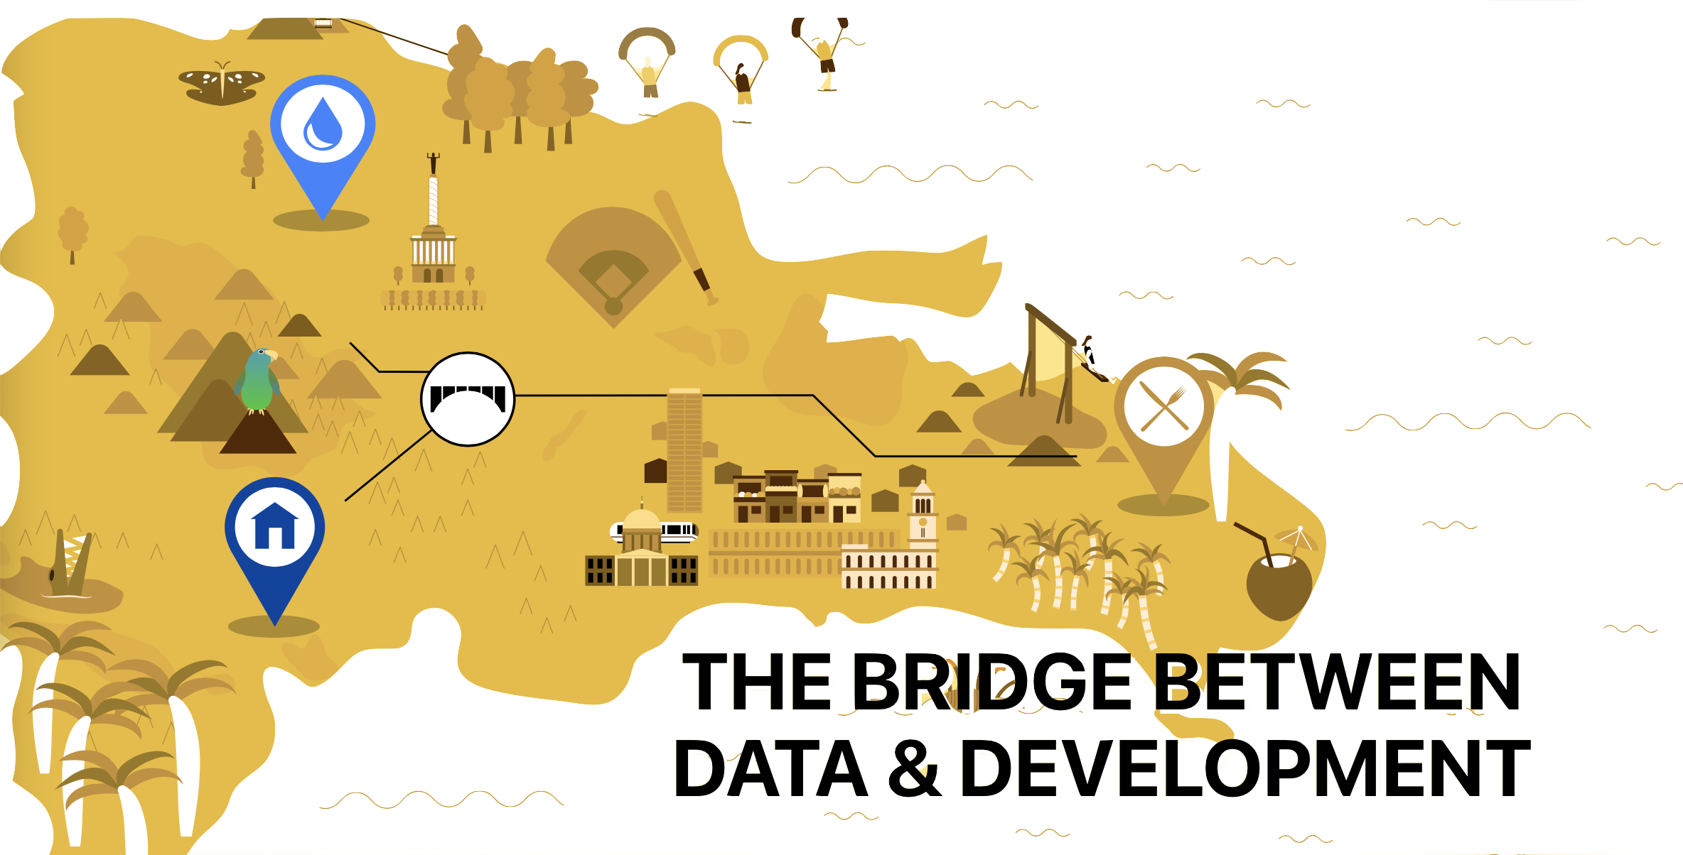

Hamza Baccouche, Katherine Berry, Drue Froeschke, Mattias Siimar

Slide 2
KEY FINDINGS

Slide 3
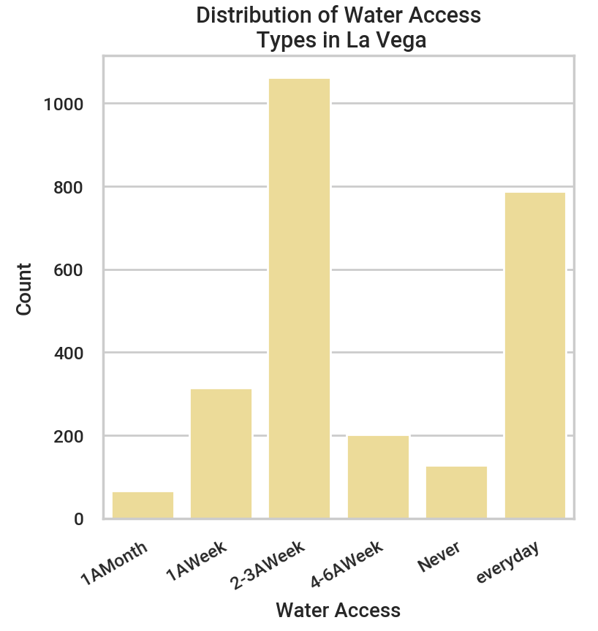

DISTRIBUTION OF WATER ACCESS
Notes:
KATHERINE
This graph shows how frequently residents in La Vega and Santiago have access to water ranging from everyday to never. Majority of residents in La Vega have access to water 2-3 times/week or everyday.

Slide 4
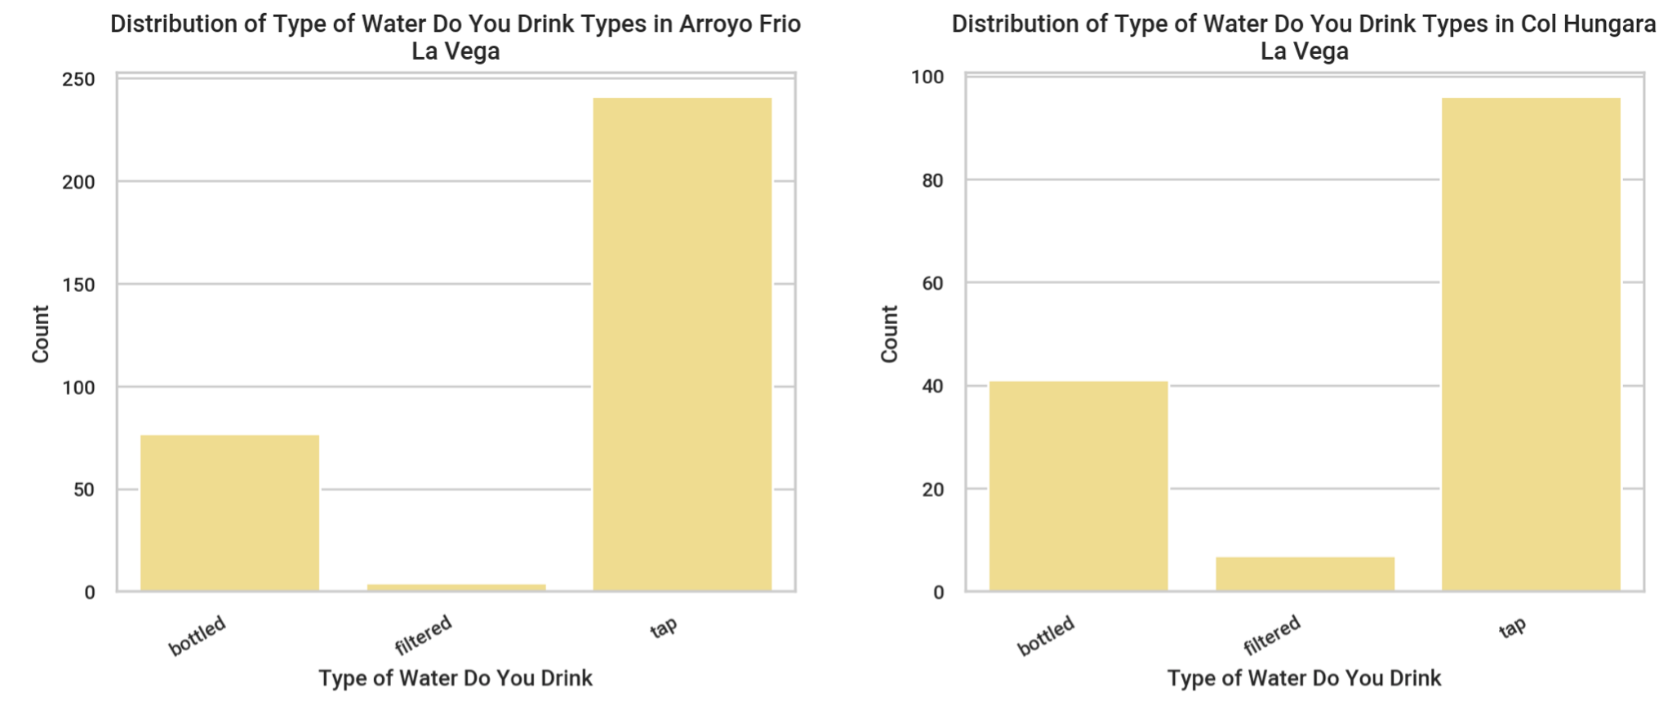
DISTRIBUTION OF TYPE OF WATER
Notes:
KATHERINE
These graphs show the type of water La Vega residents drink, broken down by community within the La Vega Province. Overall in La Vega, a lot of residents drink tap water (compared to a lot of other provinces)

Slide 5
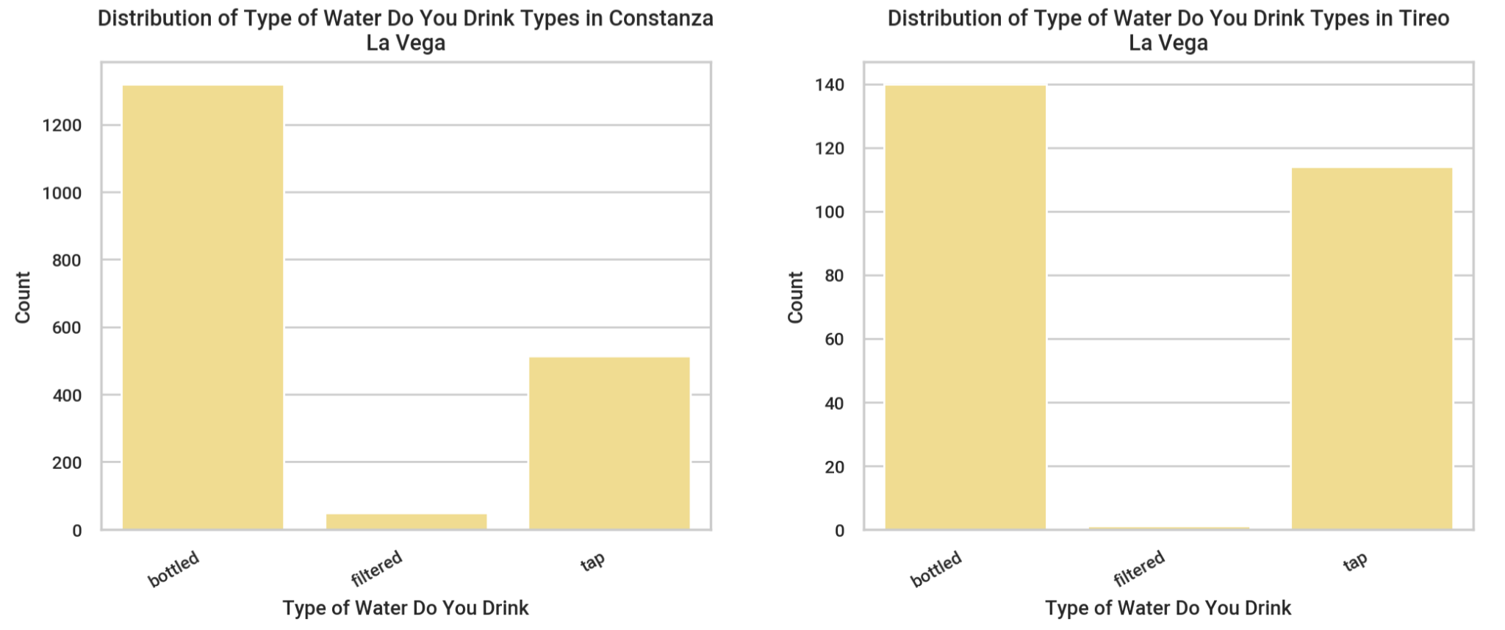
DISTRIBUTION OF TYPE OF WATER (CONT.)
Notes:
KATHERINE
These graphs show more communities, continuing to show how much tap water is being consumed.

Slide 6
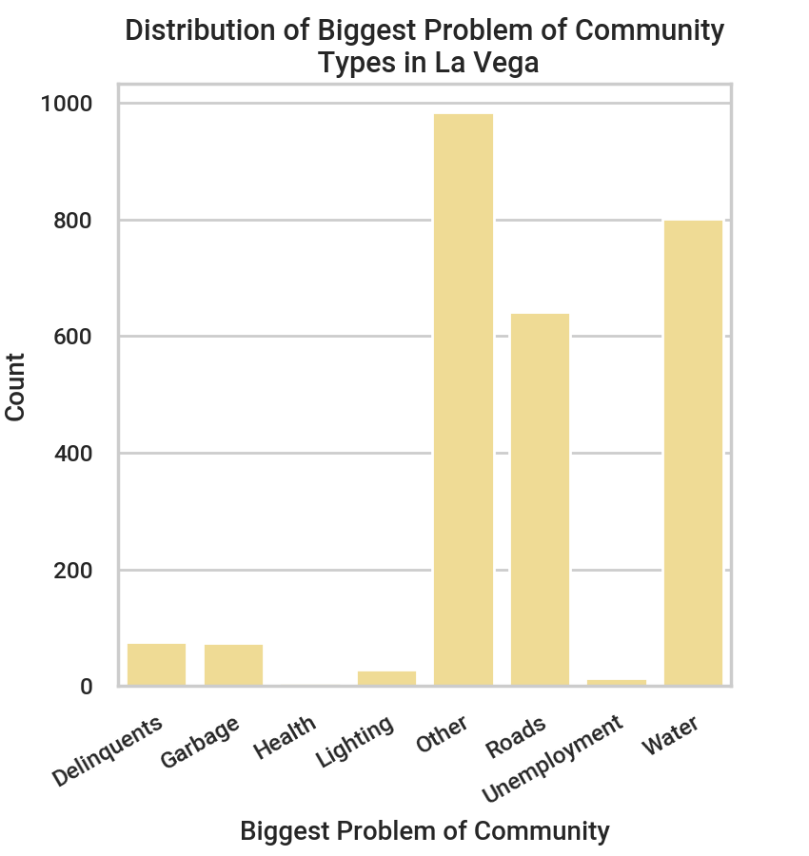

DISTRIBUTION OF BIGGEST PROBLEM
Notes:
KATHERINE
This graph shows that community members felt that their largest issue was water, which was interesting because they mostly drank tap water.

Slide 7
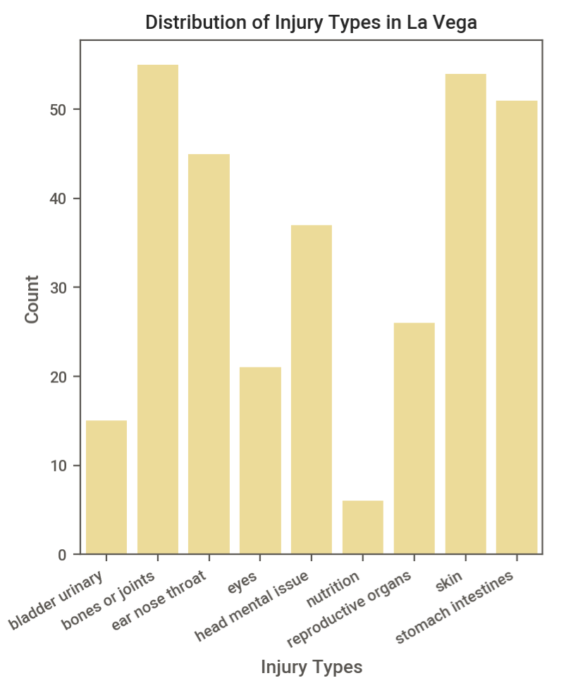
DISTRIBUTION OF INJURY TYPE
Notes:
KATHERINE
This graph makes it clear to us that people in the La Vega province have issues with stomach intestines which could be caused by unclean tap water.

Slide 8

KEY FINDING
La Vega drinks a lot of tap water, and they have high rates of stomach and intestinal issues
Notes:
KATHERINE
Based on these findings, Puente should consider implementing more water filtration systems in order for people to avoid several health issues.
Now over to Hamza to go over a different Province.

Slide 9
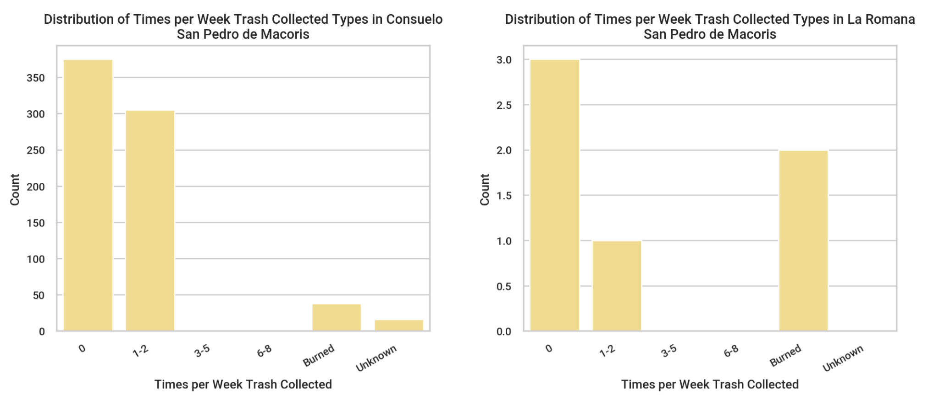
DISTRIBUTION OF TRASH COLLECTION
Notes:
HAMZA
These graphs show the frequency of trash collection in San Pedro, broken down by community, with most residents having trash collection not at all during the week, some only 1-2 times, and some burned.

Slide 10
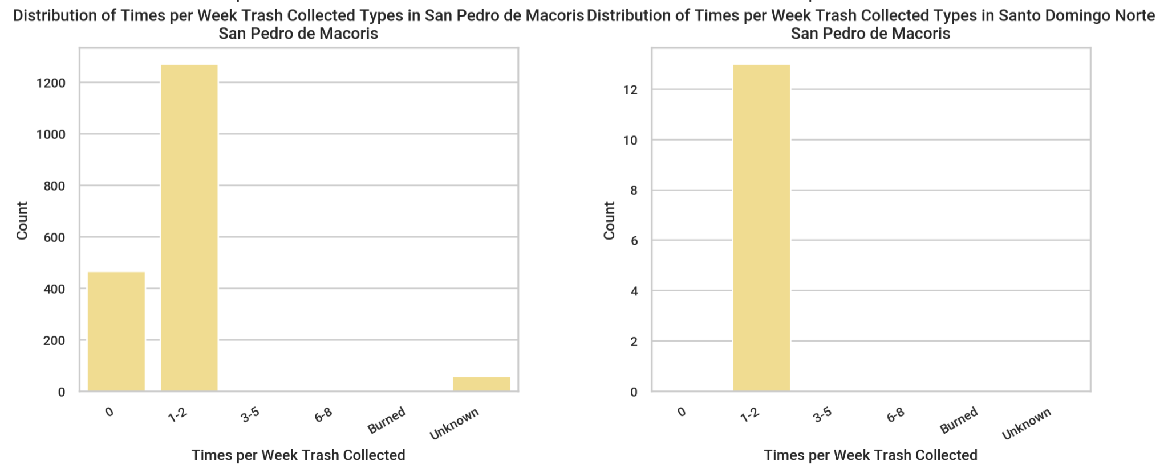
DISTRIBUTION OF TRASH COLLECTION
Notes:
HAMZA
These graphs show more communities, continuing to show how infrequently trash is being collected.

Slide 11
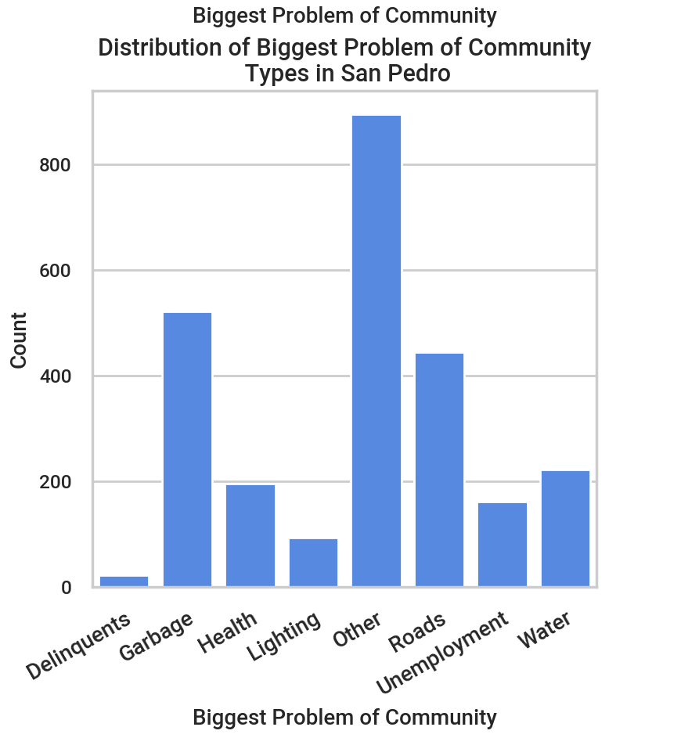
DISTRIBUTION OF BIGGEST PROBLEM
Notes:
HAMZA
This graph shows that community members felt that their largest issue was other, followed by garbage, potentially because of the lack of collection.

Slide 12
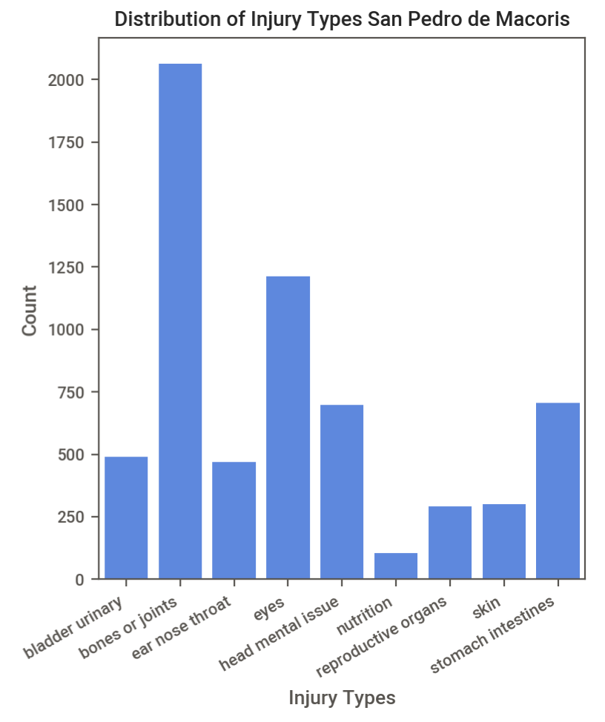
DISTRIBUTION OF INJURY TYPE
Notes:
HAMZA
This graph makes it clear to us that people in the San Pedro province have issues with their eyes, stomach and gastrointestinal problems, as well as ear/nose/throat problems, all of which could be connected to too much garbage in the community.

Slide 13
KEY FINDING
The San Pedro de Macoris community has a high rate of eye and ear/nose/throat issues, which could be a result of garbage not being collected enough or being burned
Notes:
HAMZA
Based on these findings, Puente should consider collecting trash in San Pedro more frequently in order for people to avoid several health issues.

Slide 14
CORRELATIONS

Slide 15
CORRELATIONS
For reference, an r value indicates the correlation coefficient, and it ranges from -1 to 1. When r is close to -1 or 1, the more closely those two variables are related. An r value close to 0 indicates that there is no significant relationship between the two variables.
Notes:
HAMZA
Based on these findings, Puente should consider collecting trash in San Pedro more frequently in order for people to avoid several health issues.

Slide 16
CORRELATIONS
The correlation between condition of cement floors and condition of the roof in a house, meaning if one is poor, the other typically is too, is r ≈ 0.4.
Notes:
HAMZA
Based on these findings, Puente should consider collecting trash in San Pedro more frequently in order for people to avoid several health issues.

Slide 17
CORRELATIONS
The correlation between years lived in a given house and years lived in the community, meaning people usually stay in one house and don't move houses often, is r ≈ 0.65.
Notes:
HAMZA
Based on these findings, Puente should consider collecting trash in San Pedro more frequently in order for people to avoid several health issues.

Slide 18
CORRELATIONS
There is a much stronger correlation between where you go for medical problems and where you go for dental problems for those who answered Ramon Santana Hospital (r ≈ 0.85) vs, other responses (r ≈ 0.5), meaning those who go to Ramon Santana are much more likely to go there for both medical and dental services, whereas other responses aren't as likely to go to the same place for medical and dental services.
Notes:
HAMZA
Based on these findings, Puente should consider collecting trash in San Pedro more frequently in order for people to avoid several health issues.

Slide 19
CORRELATIONS
The correlation between having no water access and believing the biggest problem of your community is water, meaning people who don't have water access believe that to be a bigger problem than others like crime, infrastructure, lack of healthcare, etc. when those other problems also occur, is r ≈ 0.45.
Notes:
HAMZA
Based on these findings, Puente should consider collecting trash in San Pedro more frequently in order for people to avoid several health issues.

Slide 20
EXTRA VISUALIZATIONS

Slide 21
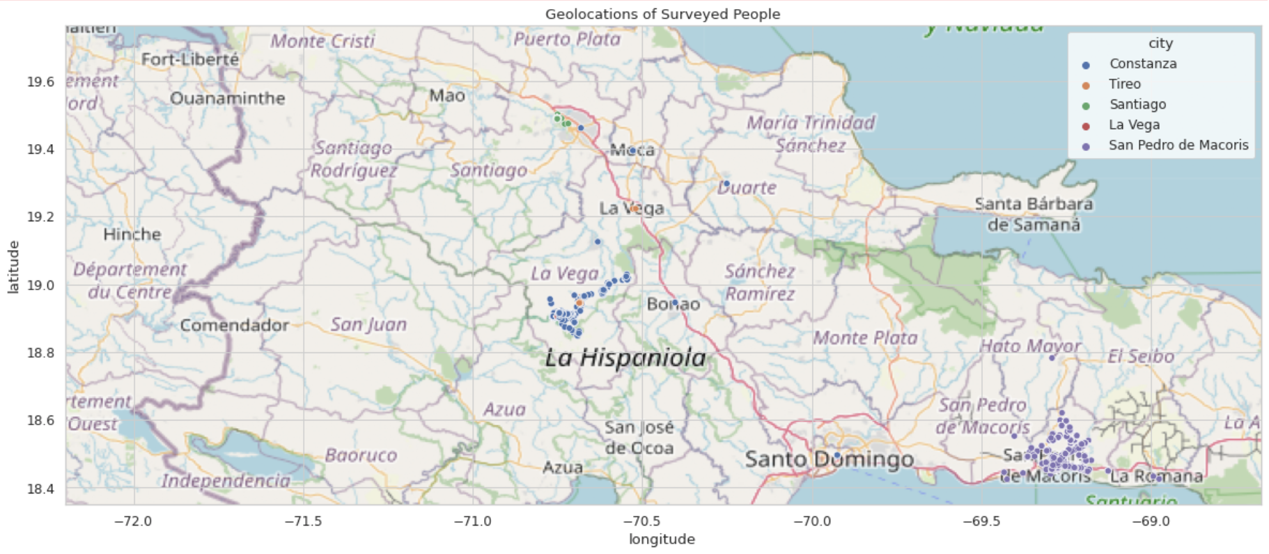
RESPONDENT LOCATIONS
Notes:
This graph shows a high level overview of where the respondents of the datasets are located within the Dominican Republic.

Slide 22
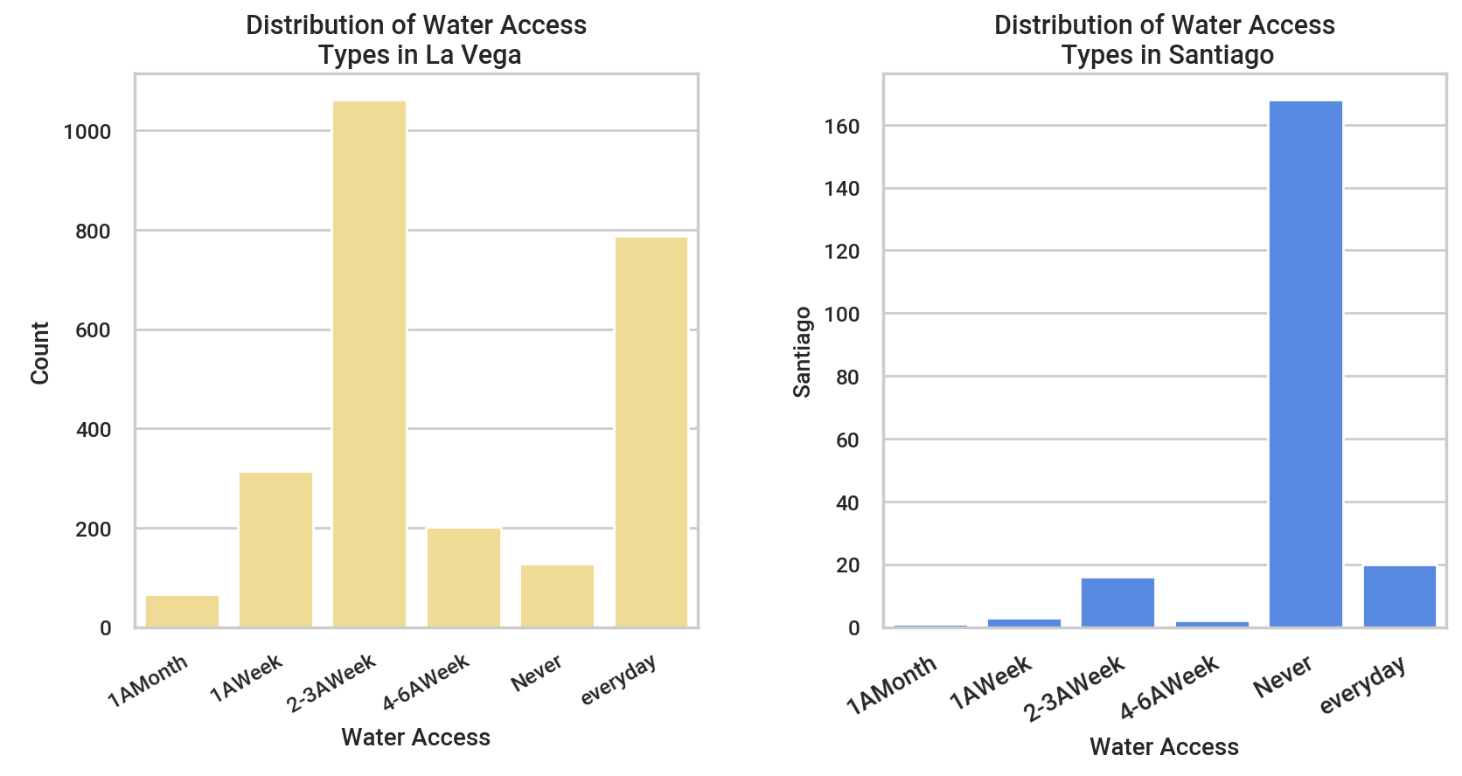
DISTRIBUTION OF WATER ACCESS
Notes:
This graph shows how frequently residents in La Vega, Santiago, San Pedro, and North San Pedro have access to water ranging from everyday to never.

Slide 23
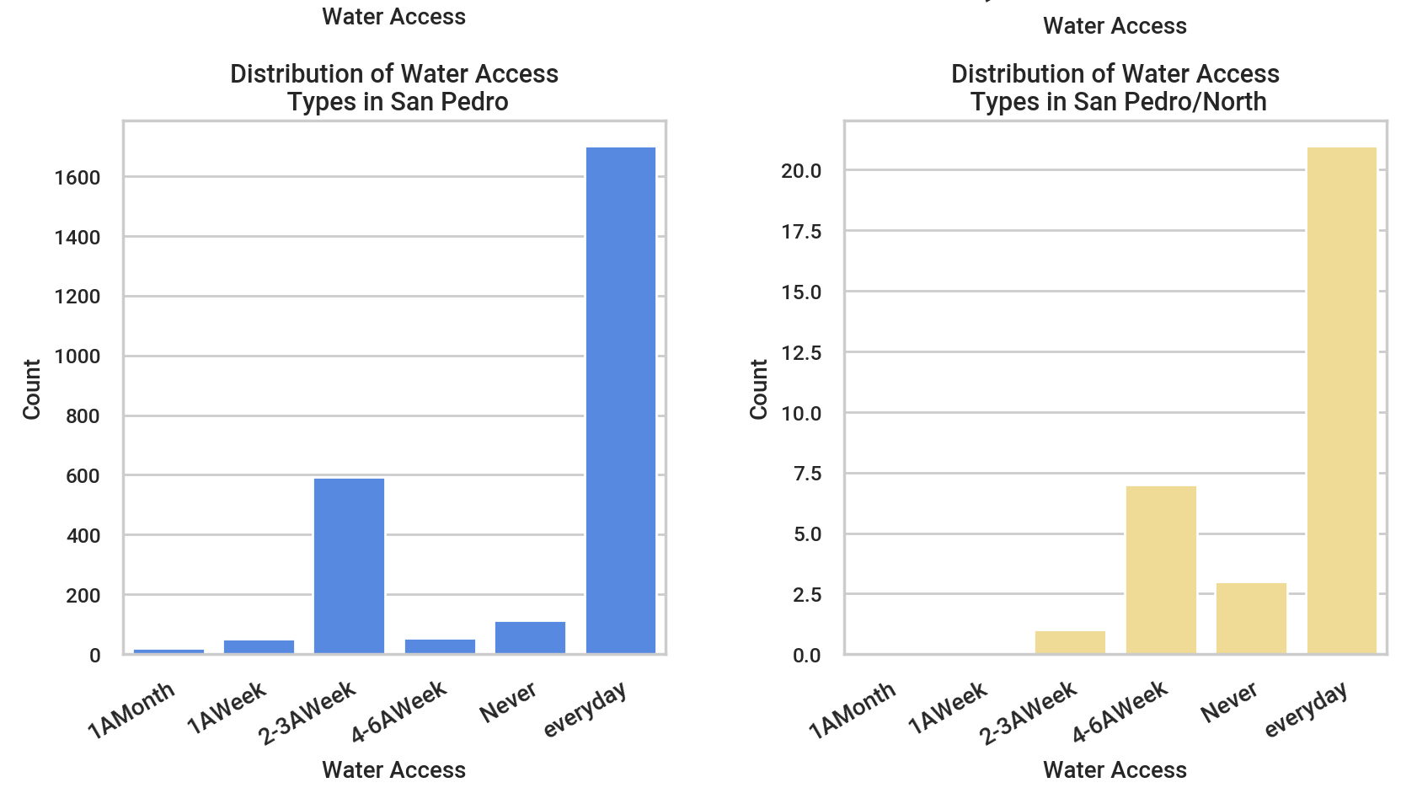
DISTRIBUTION OF WATER ACCESS
Notes:
This graph shows how frequently residents in La Vega, Santiago, San Pedro, and North San Pedro have access to water ranging from everyday to never.

Slide 24
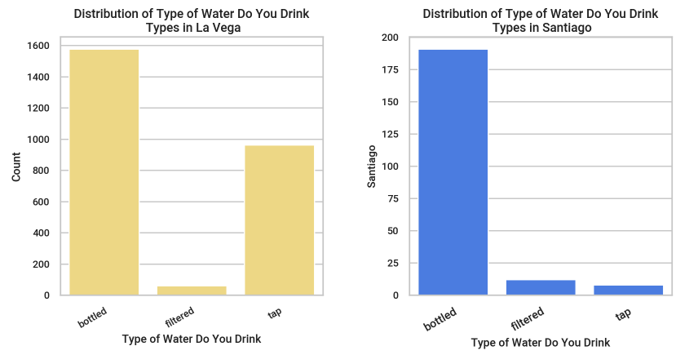
DISTRIBUTION OF WATER TYPE
Notes:
This graph shows what type of water residents in these communities have access to, with the three types of water being bottled, filtered, or tap. As you can see, an overwhelming majority of citizens in all communities have most access to bottled water, with very little having access to filtered water.

Slide 25
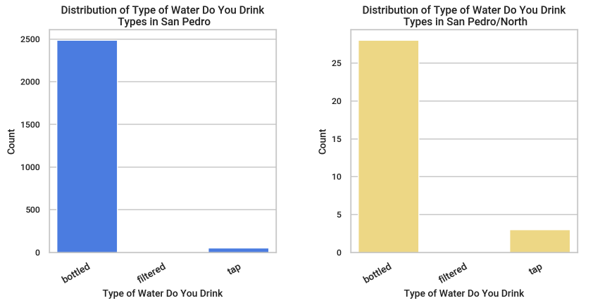
DISTRIBUTION OF WATER TYPE
Notes:
This graph shows what type of water residents in these communities have access to, with the three types of water being bottled, filtered, or tap. As you can see, an overwhelming majority of citizens in all communities have most access to bottled water, with very little having access to filtered water.

Slide 26
DISTRIBUTION OF TYPE OF WATER (LA VEGA)
Notes:
These graphs show the type of water La Vega residents drink, broken down by provinces within the La Vega community. Overall in La Vega, a majority of residents drink tap water, but as you can see multiple provinces actually drink more bottled water than tap.

Slide 27
DISTRIBUTION OF TYPE OF WATER (LA VEGA)
Notes:
These graphs show the type of water La Vega residents drink, broken down by provinces within the La Vega community. Overall in La Vega, a majority of residents drink tap water, but as you can see multiple provinces actually drink more bottled water than tap.

Slide 28
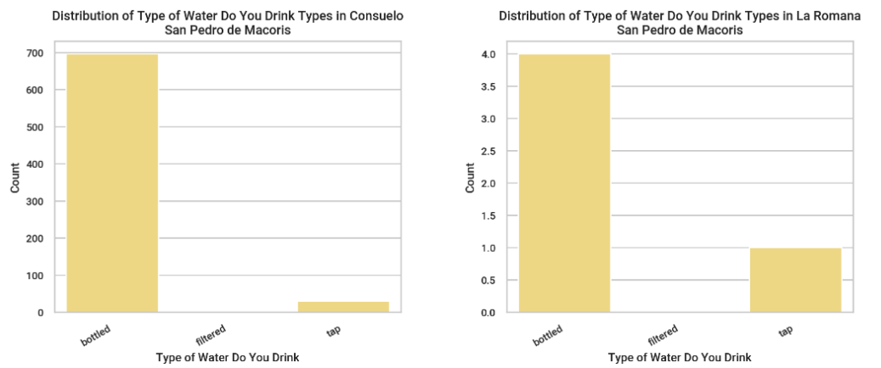
DISTRIBUTION OF TYPE OF WATER (SAN PEDRO)
Notes:
These graphs show the type of water San Pedro residents drink, broken down by provinces within the San Pedro community. Overall, San Pedro residents drink the most from bottled water, and this is depicted in these graphs where all provinces drink majority bottled water.

Slide 29
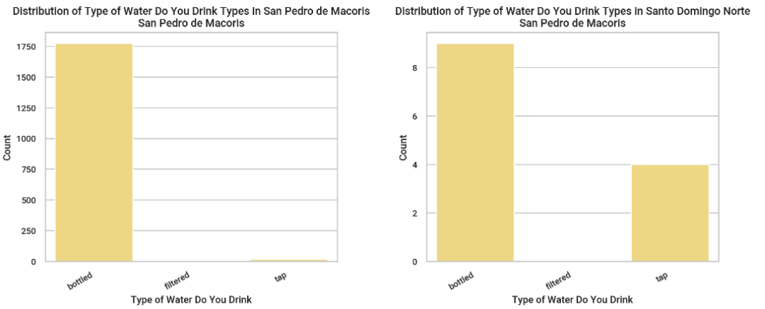
DISTRIBUTION OF TYPE OF WATER (SAN PEDRO)
Notes:
These graphs show the type of water San Pedro residents drink, broken down by provinces within the San Pedro community. Overall, San Pedro residents drink the most from bottled water, and this is depicted in these graphs where all provinces drink majority bottled water.

Slide 30
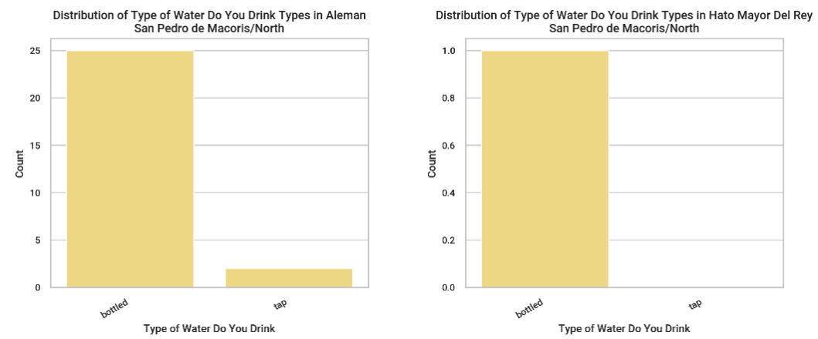
DISTRIBUTION OF TYPE OF WATER (NORTH SAN PEDRO)
Notes:
These graphs show the type of water North San Pedro residents drink, broken down by provinces within the North San Pedro community. Overall, North San Pedro residents drink the most from bottled water, and this is depicted in these graphs where all provinces drink majority bottled water. The fourth graph is blank because there are only three provinces in North San Pedro.

Slide 31
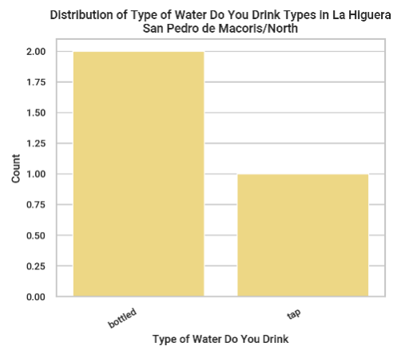
DISTRIBUTION OF TYPE OF WATER (NORTH SAN PEDRO)
Notes:
These graphs show the type of water North San Pedro residents drink, broken down by provinces within the North San Pedro community. Overall, North San Pedro residents drink the most from bottled water, and this is depicted in these graphs where all provinces drink majority bottled water.

Slide 32
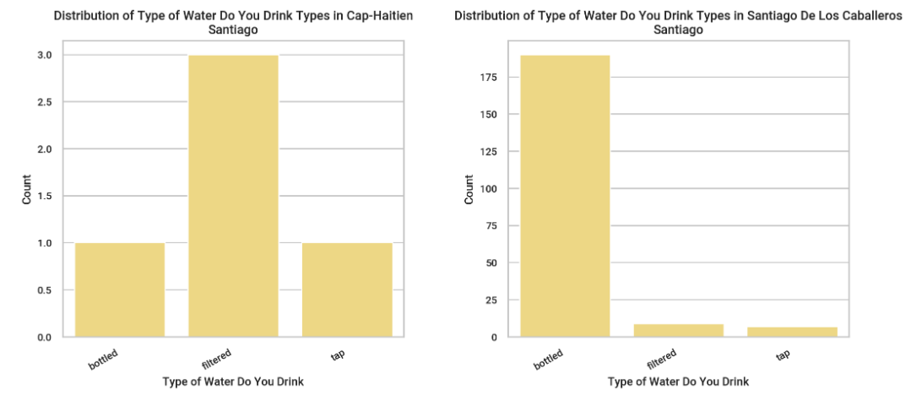
DISTRIBUTION OF TYPE OF WATER (SANTIAGO)
Notes:
These graphs show the type of water Santiago residents drink, broken down by provinces within the Santiago community. Overall, Santiago residents drink the most from bottled water, but as you can see one province actually drinks more filtered water than tap.

Slide 33
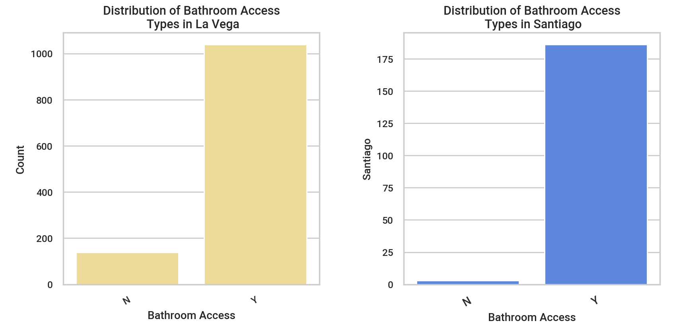
DISTRIBUTION OF BATHROOM ACCESS
Notes:
This graph shows whether or not residents of the communities have regular access to a bathroom. In most communities, a majority of residents have access to a bathroom, with North San Pedro being an exception to that as most residents do not have access to a bathroom.

Slide 34
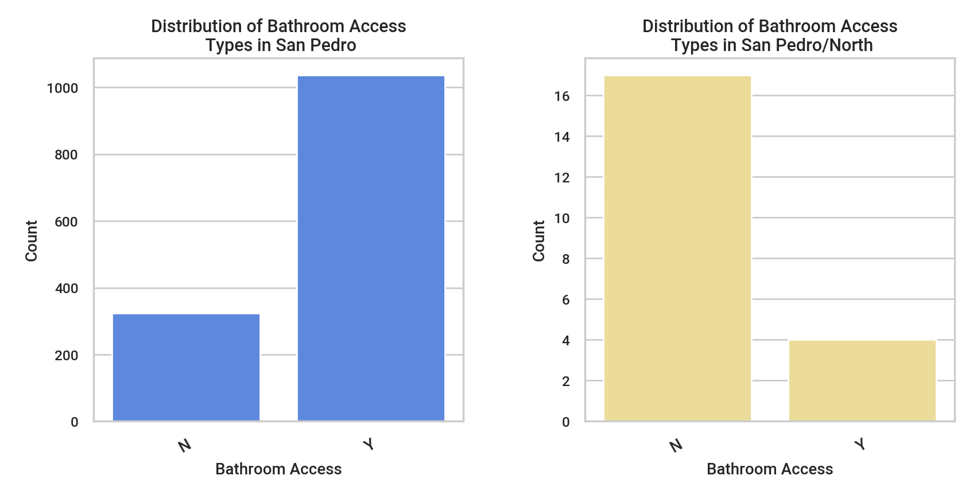
DISTRIBUTION OF BATHROOM ACCESS
Notes:
This graph shows whether or not residents of the communities have regular access to a bathroom. In most communities, a majority of residents have access to a bathroom, with North San Pedro being an exception to that as most residents do not have access to a bathroom.

Slide 35
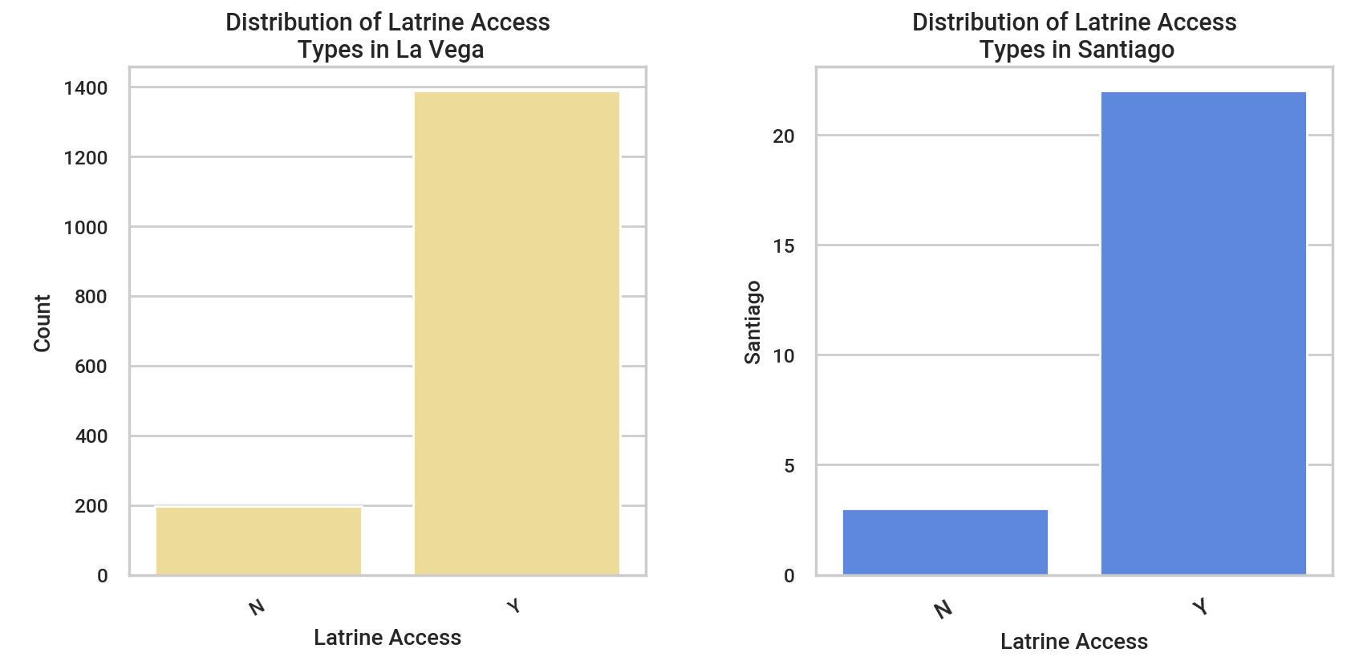
DISTRIBUTION OF LATRINE ACCESS
Notes:
This graph shows whether or not residents of the communities have regular access to a latrine. In most communities, a majority of residents have access to a bathroom, with North San Pedro being an exception to that as most residents do not have access to a latrine.

Slide 36
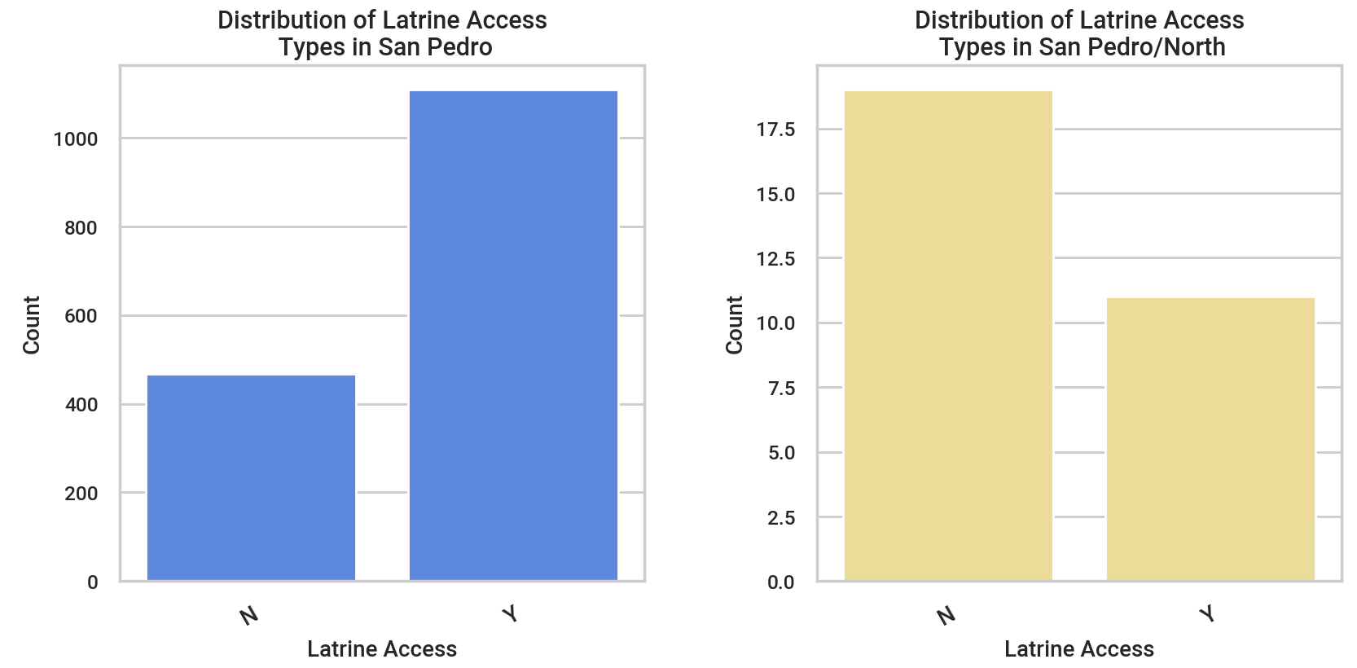
DISTRIBUTION OF LATRINE ACCESS
Notes:
This graph shows whether or not residents of the communities have regular access to a latrine. In most communities, a majority of residents have access to a bathroom, with North San Pedro being an exception to that as most residents do not have access to a latrine.

Slide 37
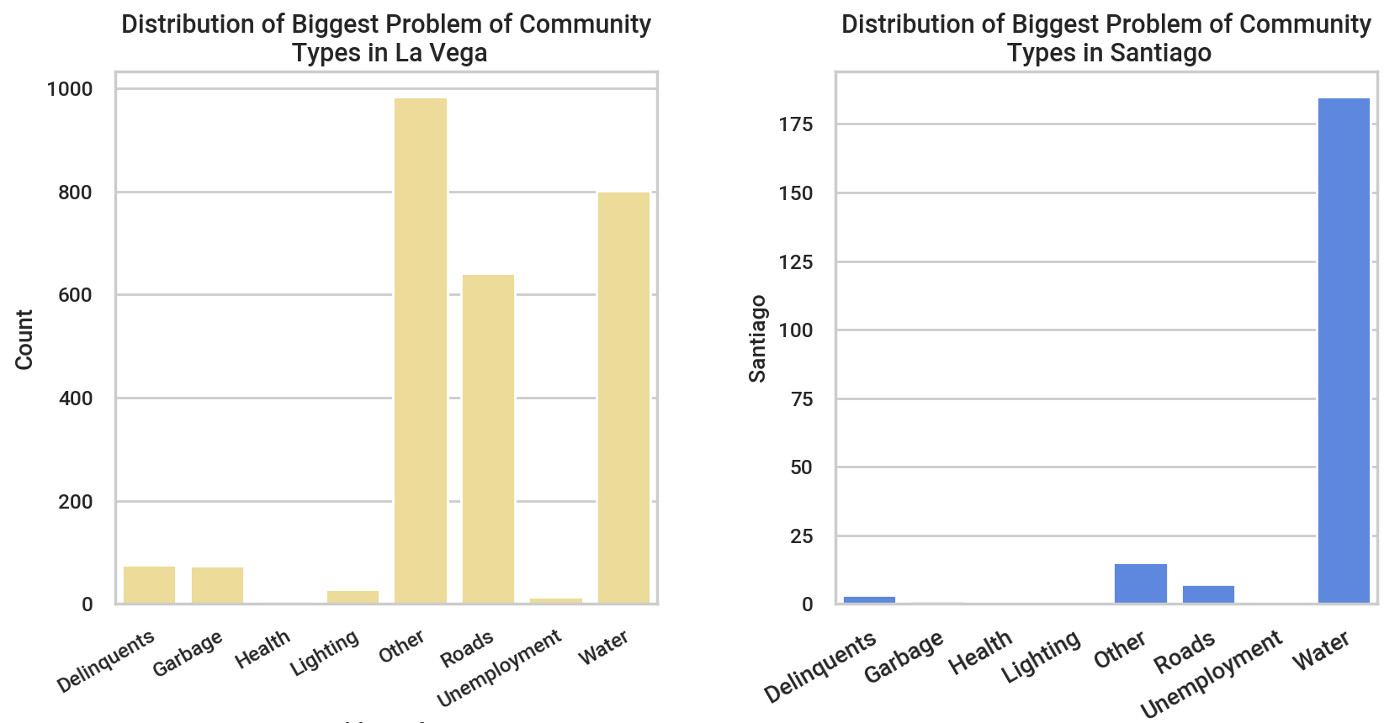
DISTRIBUTION OF BIGGEST PROBLEM
Notes:
This graph shows what community members felt their biggest problem throughout their specific community is. Many respondents chose other, indicating their biggest community problem was not listed. Other prominent issues that members across communities are concerned about were water and roads, with San Pedro also being concerned about garbage disposal.

Slide 38
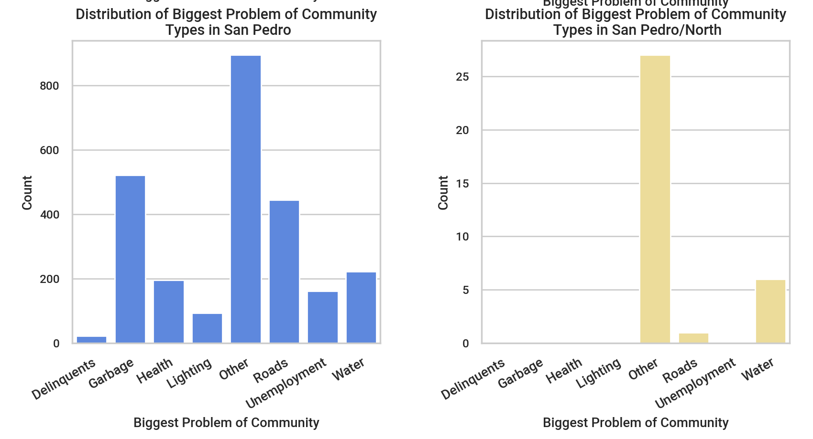
DISTRIBUTION OF BIGGEST PROBLEM
Notes:
This graph shows what community members felt their biggest problem throughout their specific community is. Many respondents chose other, indicating their biggest community problem was not listed. Other prominent issues that members across communities are concerned about were water and roads, with San Pedro also being concerned about garbage disposal.

Slide 39
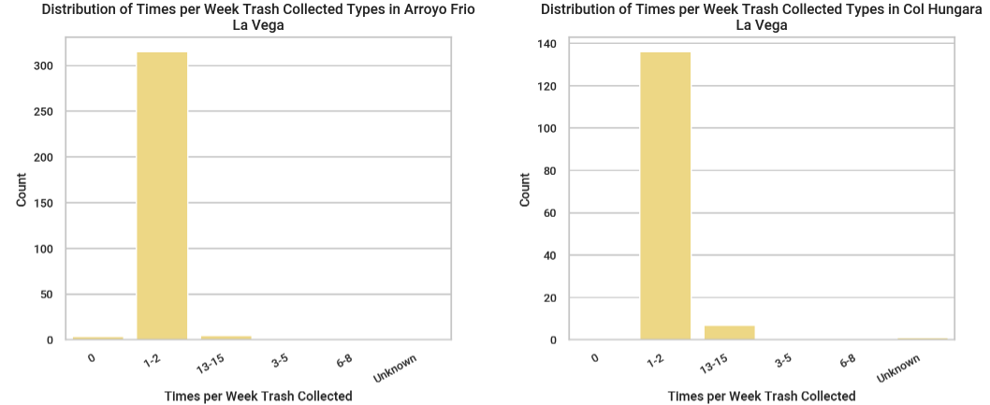
DISTRIBUTION OF TRASH COLLECTION (LA VEGA)
Notes:
These graphs show the frequency of trash collection in La Vega, broken down by province, with the majority of residents having trash collected 1-2 times per week.

Slide 40
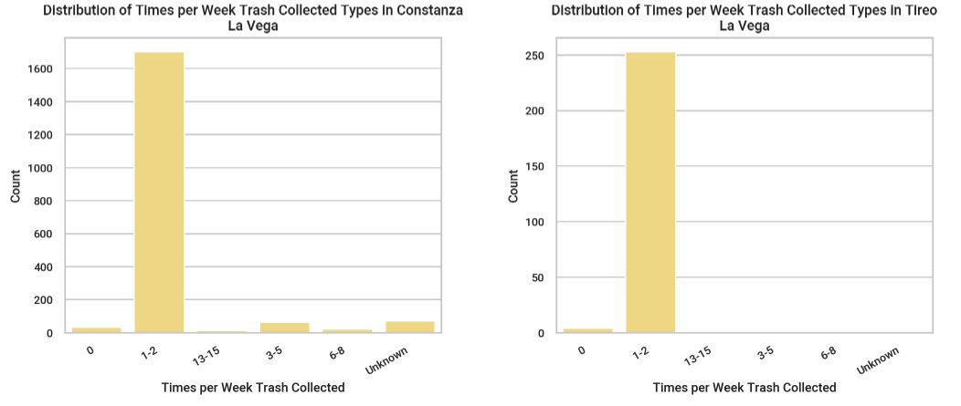
DISTRIBUTION OF TRASH COLLECTION (LA VEGA)
Notes:
These graphs show the frequency of trash collection in La Vega, broken down by province, with the majority of residents having trash collected 1-2 times per week.

Slide 41
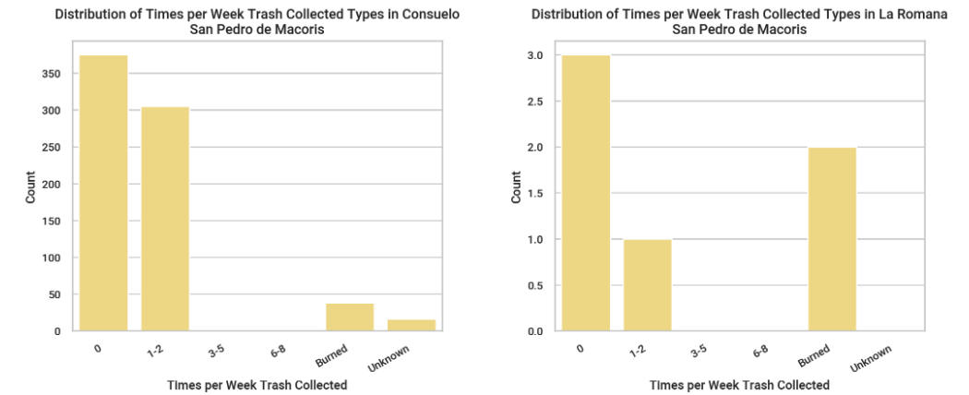
DISTRIBUTION OF TRASH COLLECTION (SAN PEDRO)
Notes:
These graphs show the frequency of trash collection in San Pedro, broken down by province, with most residents having trash collection 1-2 times per week, or 0 times.

Slide 42
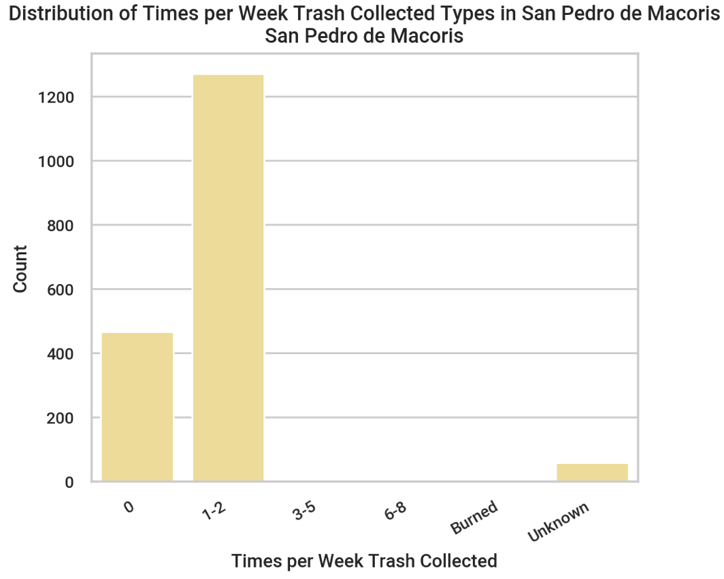
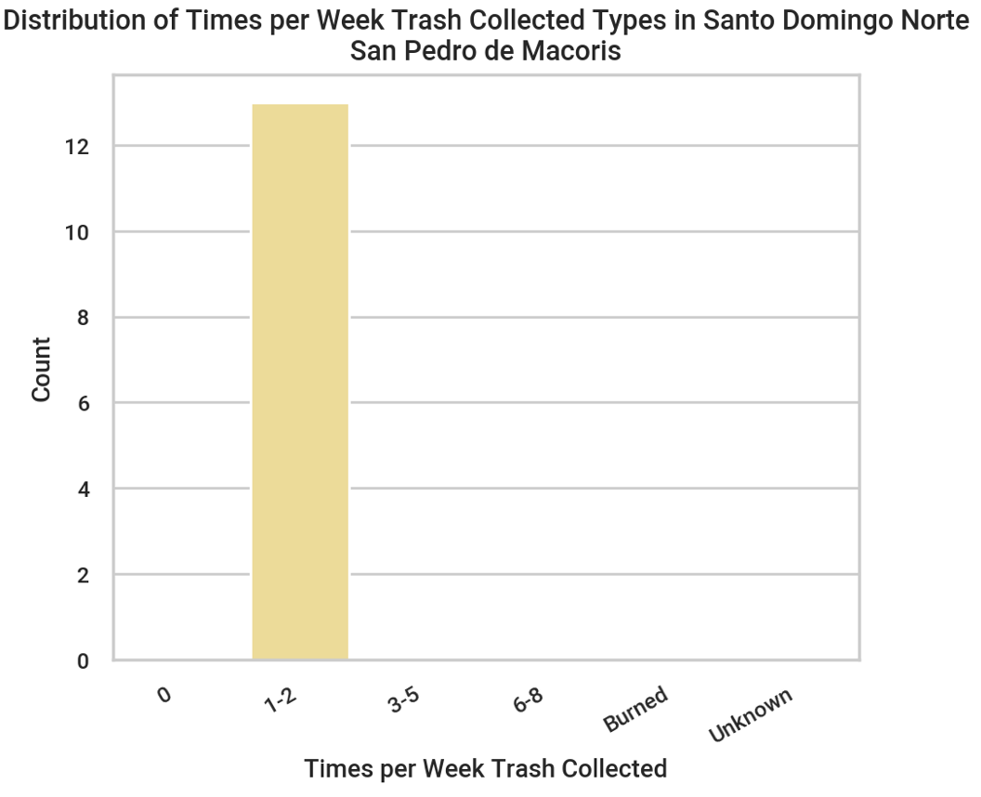
DISTRIBUTION OF TRASH COLLECTION (SAN PEDRO)
Notes:
These graphs show the frequency of trash collection in San Pedro, broken down by province, with most residents having trash collection 1-2 times per week, or 0 times.

Slide 43
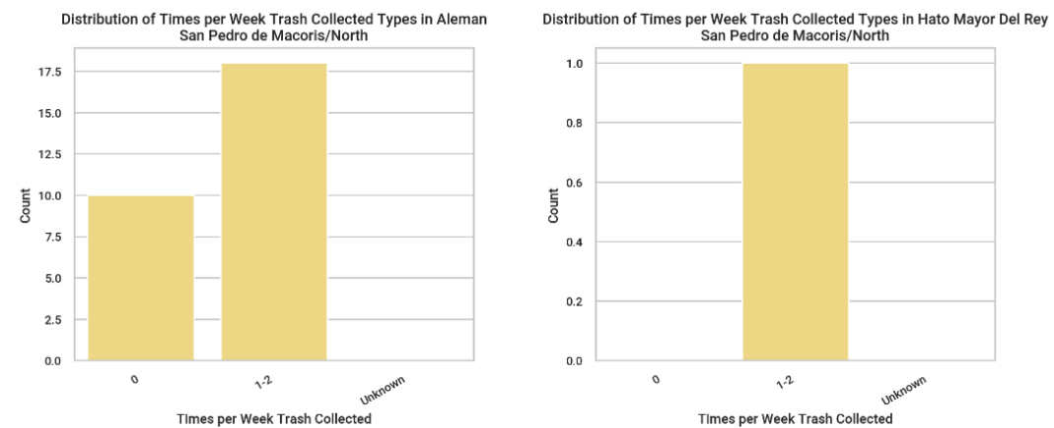
DISTRIBUTION OF TRASH COLLECTION (NORTH SAN PEDRO)
Notes:
These graphs show the frequency of trash collection in North San Pedro, broken down by province, with a varied distribution among never, 1-2 times a week, and unknown.

Slide 44
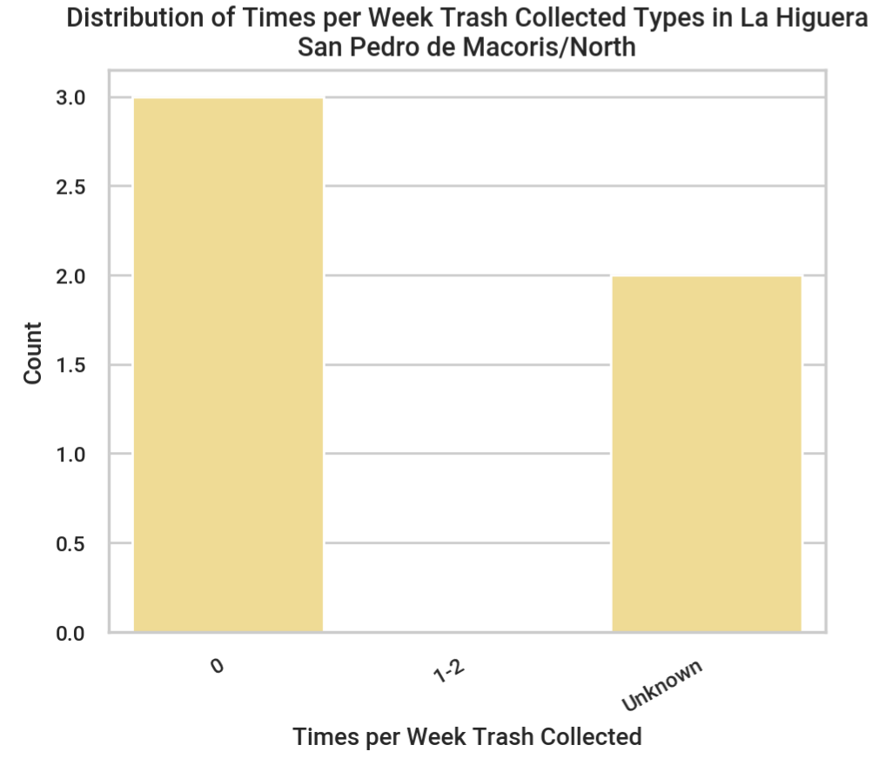
DISTRIBUTION OF TRASH COLLECTION (NORTH SAN PEDRO)
Notes:
These graphs show the frequency of trash collection in North San Pedro, broken down by province, with a varied distribution among never, 1-2 times a week, and unknown.

Slide 45
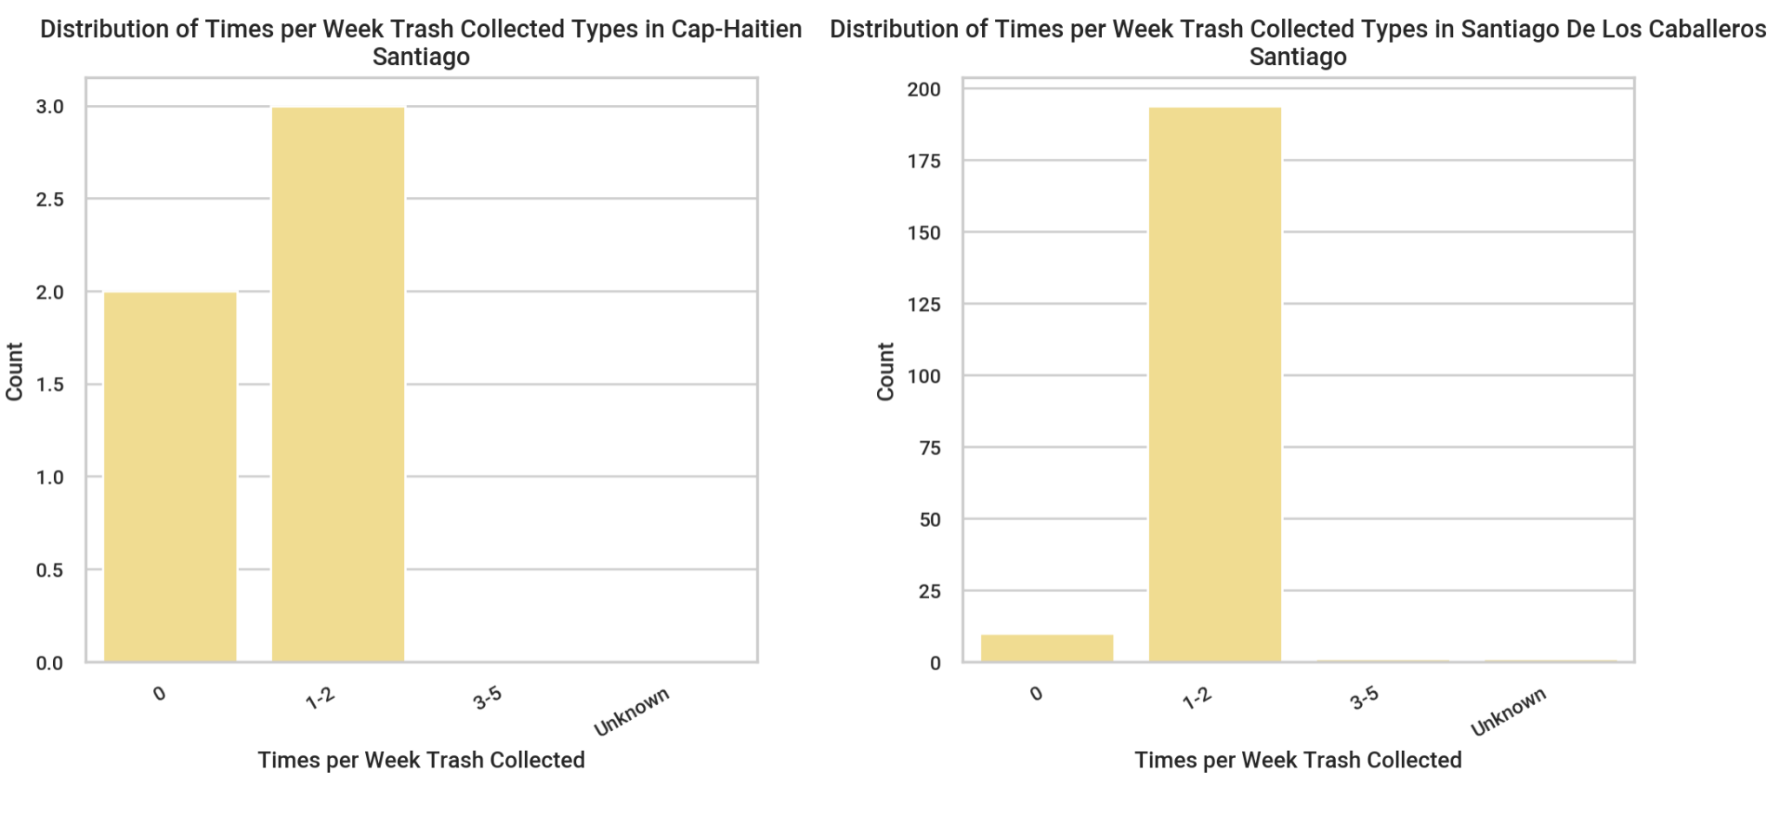
DISTRIBUTION OF TRASH COLLECTION (SANTIAGO)
Notes:
These graphs show the frequency of trash collection in Santiago, broken down by province, with the majority of residents having trash collected 1-2 times per week.

Slide 46
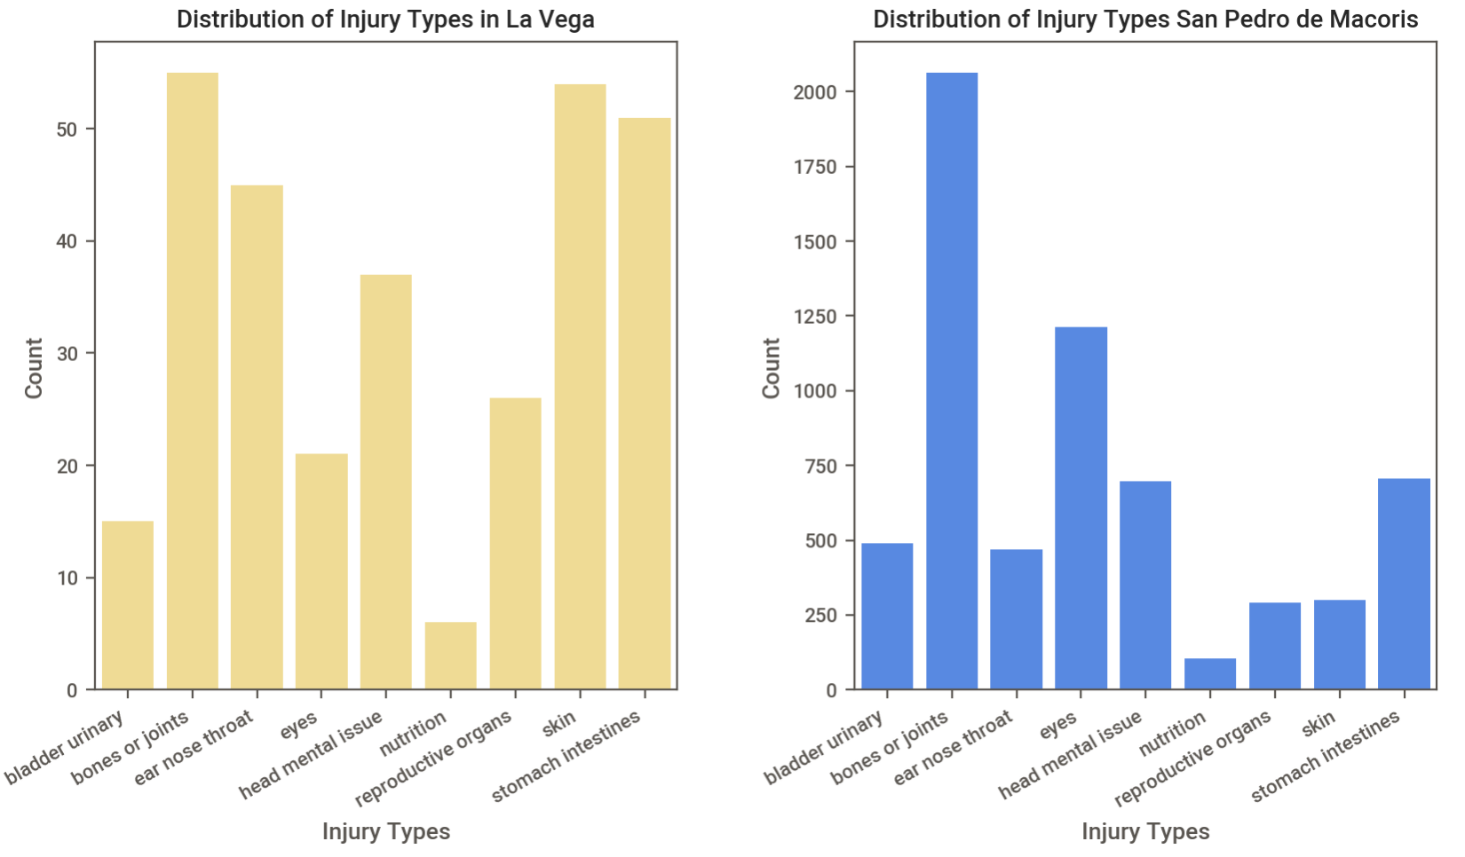
DISTRIBUTION OF INJURY TYPE
Notes:
These graphs show the frequency of various injuries that happen to residents in La Vega and San Pedro. The most prevalent injury in both communities is bone or joint related, with La Vega also having a high frequency of skin and intestine injuries.

Slide 47
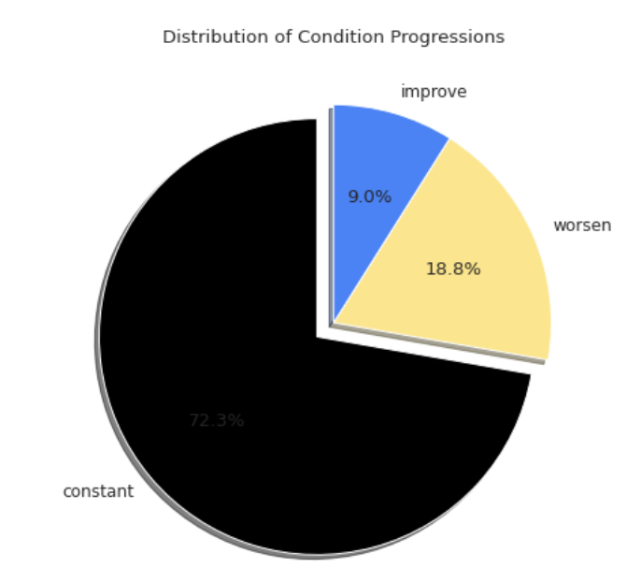
DISTRIBUTION OF TRAUMA AND PROGRESS
72.2%
Notes:
These graphs break down the trauma progression graph to show progress for various parts of the body. The percentage graph shows that, although eyes related traumas are not the most prominent type of injury, they are the most likely to actually worsen. The same graph shows that skin related injuries are most likely to stay constant, having no progression.

Slide 48
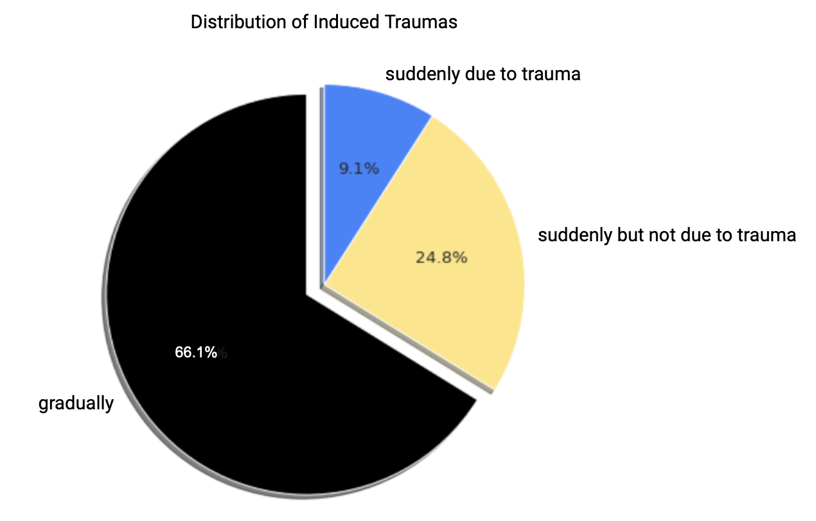
DISTRIBUTION OF TRAUMA AND PROGRESS
72.3%
Notes:
The first graph shows how suddenly trauma started for residents of the Dominican Republic. This graph shows that a vast majority of trauma cases start gradually. The seconds graph shows condition progress of trauma cases. A very small minority of cases improve, with the majority seeing no change at all, and almost 20% of cases actually worsening.

Slide 49
Notes:
Thanks for listening! Any questions?

